Slide 1

Interpreting and Explaining Covid-19 Chest X-ray Image Classifier using Tensorview and Paraview
Team: Visualizers Members: Fariha Moomtaheen | Parush Gera | Ashik Barua April 25, 2021
Notes:
Hello eveyone, this is Fariha Moomtaheen, from team visualizers. My other teammates are Parush gera and ashik barua. The topic for our presentation is Covid-19 Visualization and interpretablility. Here, we're basically trying to visulize what actually goes on inside a deep neural network, while training the model.

Slide 2
Contents
Introduction
Related work
Dataset
Model
Methods
Visualizations
Challenges
Notes:
In this presentation we will be presenting the following topics. First we will talk about Introduction of our project, then …....

Slide 3
Introduction

Slide 4
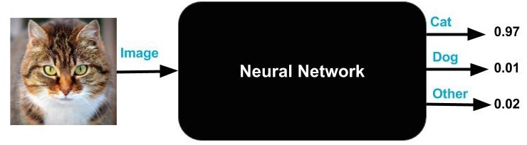
Introduction
Deep Learning is used widely for image classification.
It has aided in detecting Cancer and Tumors
Deep Learning is a black box
We classify COVID-19 chest X-ray images
Goal: To interpret and explain the model
Notes:
Machine learning and deep neural network models is being used in medical field for detecting diseases and future prediction of a lot of critical diseases, like cancer and tumors.
However, the black box nature of machine learning and deep learning models is a hindrance for the healthcare professionals and researchers to visualize and explain what an algorithm sees. We worked on covid-19 chest x-ray images and made visualizations of parts of the processes during the runtime of the model.

Slide 5
Goals
To visualize the dynamics of any deep neural network to help people to understand how these artificial networks learn from data and make predictions.
Tools Used : Python, Tensorflow, Tensorview API, Paraview[5] , Tableau
Notes:
To visualize the dynamics of any deep neural network to help people to understand how these artificial networks learn from data and make predictions.

Slide 6
Introduction
Interpretability
About the extent to which we can observe the cause and effect in a model.[1]
Explainability
About the extent to which the mechanism of machine learning and deep learning models can be explained.[1]
Notes:
Interpratibility and exp;ainibility are two terms which are used interchangibly but has a minute difference between it. I

Slide 7
Related Work

Slide 8
Related Work
Integration Methods – Using traditional machine learning methods to explain deep learning methods.
Decision tree surrogate models, local interpretable model-agnostic explanations (LIME), plots, partial dependence plots, Shapley explanations, and individual conditional expectation (ICE) can be used to explain ML models.[2][3]
Notes:
There has been put a lot of effort privously to explain and interpret deep learning models. On field is to use traditional machine learning models and modify them to interprate and explain deep learning models. This is called Integration methods. Some of the widely used examples are Decision tree surrogate models, local interpretable model-agnostic explanations (LIME), plots, partial dependence plots, Shapley explanations, and individual conditional expectation (ICE) can be used to explain ML models.

Slide 9
Dataset

Slide 10
Dataset
Total Images: 56 Images
21 COVID-19 Lung CT Images and 35 Non-COVID-19 Lung CT Images
Classes:
1. COVID-19 [6]
2. Non-COVID-19 [7]
Notes:
Since the focus of this project is not to train a model with good accuracy, but it is to visualize the process, we worked on a small dataset. There are total of 56 images. 21 COVID-19 Lung CT Images and 35 Non-COVID-19 Lung CT Images. There are two classes, COVID and NON-COVID

Slide 11
Model

Slide 12
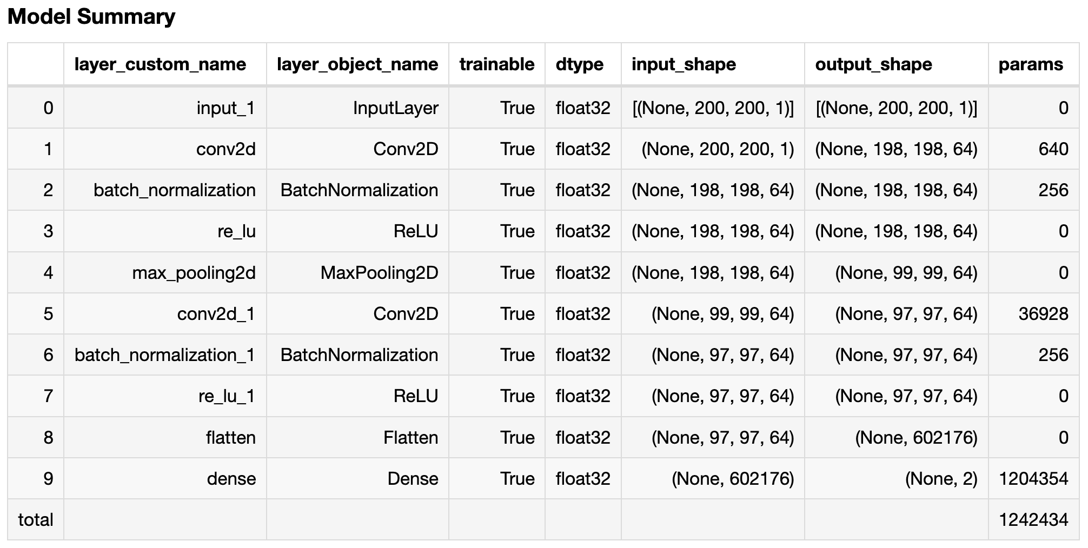
Notes:
For the ease of getting to the point of visualization we kept our model less complex. It has 8 hidden layer and one input and one dense output layer.
There are total of ~1.2 million trainiable paramters.
We used batch normalization so that that the model has fair number of informative examples to learn from in each epoch.

Slide 13
Methods

Slide 14
Methods
Visualizing Loss and accuracy while training.
Visualizing loss & accuracy over each epoch.
Visualizing kernel of each Neuron at a layer.
Visualizing Bias at each filter.
Notes:
There are some key things that we visualized in this project. Those are loss, accuracy, neurons and bias. Visualizing these key aspects can lead us to infer if the model is learning or not, or is the dataset has diverse features which are aiding the model in learning. In other words are there enough informative points in the dataset which can be used to understand the prediction process.

Slide 15
Visualizations

Slide 16
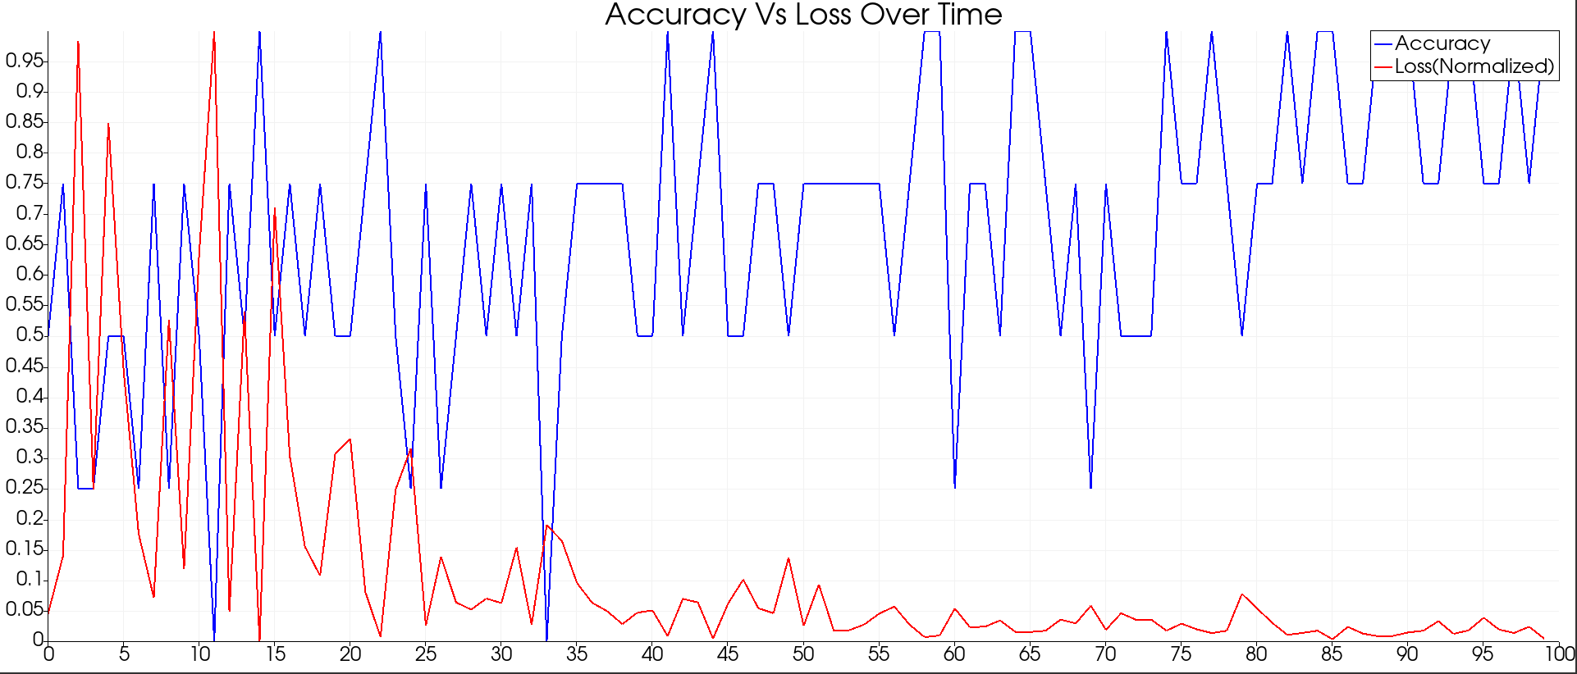
Loss and Accuracy
While the model is running, we can infer that the model is learning with each epoch.
The loss decreases and accuracy increases with each iteration.
Tool Used: TensorView API
Notes:
This visualization is generated by tensorView. The change in the accuracy and loss over each iteration/epoch can tell us that the model was struggling to learn initially, but when the data was fed into the model in random batches over 100 epochs, the accuracy increased and the loss decreased.

Slide 17
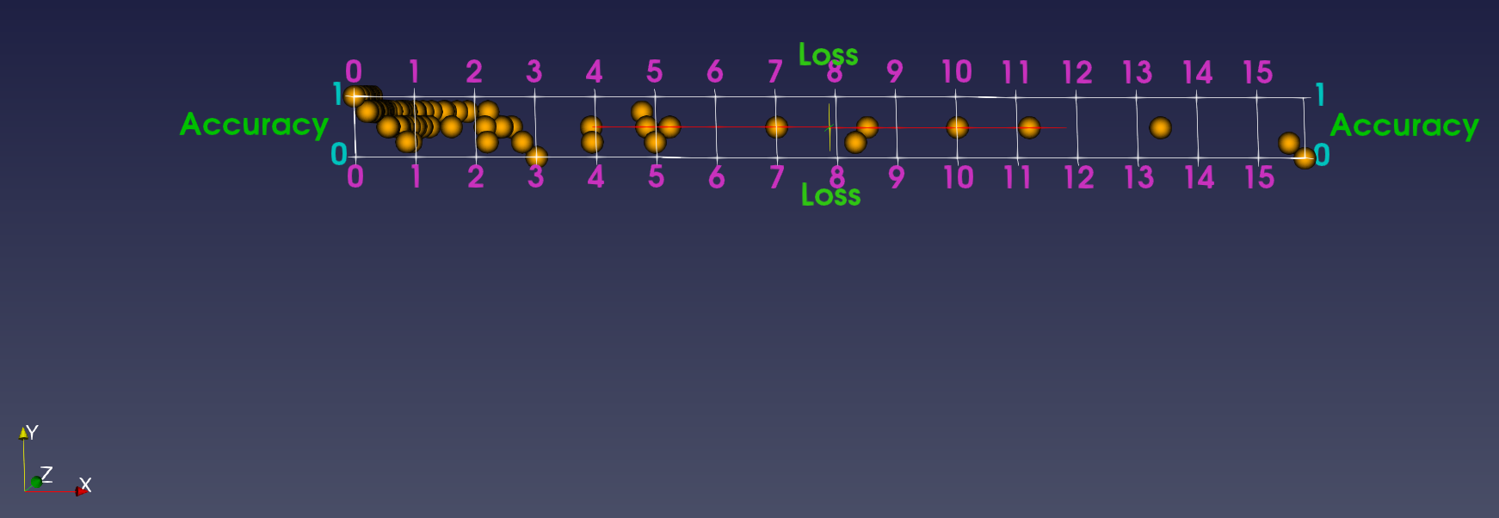
Loss and Accuracy
Using Paraview we can visualize the same data in a more interpretable manner.
Notes:
This image was generated by Paraview. We extracted the values of loss and accuracy over epochs uisng Tensorflow and Tensorview. Then the data was fed in to Paraview to visualize it. Here this visualization is viewd from right to left.
Here, the propagation of epochs is from right to left, where we can see that, the accuracy is gradually increasing from 0 to 1, and on the other hand the loss is decreasing ( that's why the propation is from right to left).

Slide 18
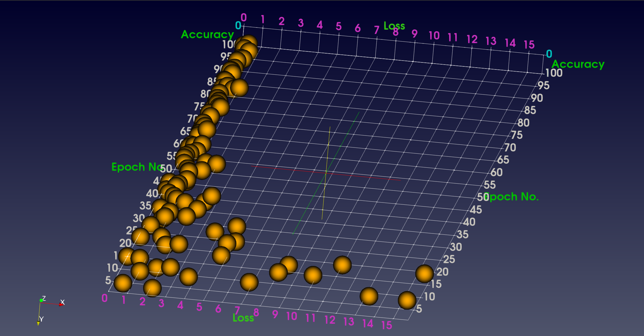
Loss and Accuracy over epochs
While using 3D visualization from Paraview, we can visualize loss, accuracy over each epoch.
This gives more explainability.
Notes:
This image was generated by Paraview. We extracted the values of loss and accuracy over epochs uisng Tensorflow and Tensorview. Then the data was fed in to Paraview to visualize it in 3 dimenstions. Here we are visualizing the loss, accuracy and the epochs.

Slide 19
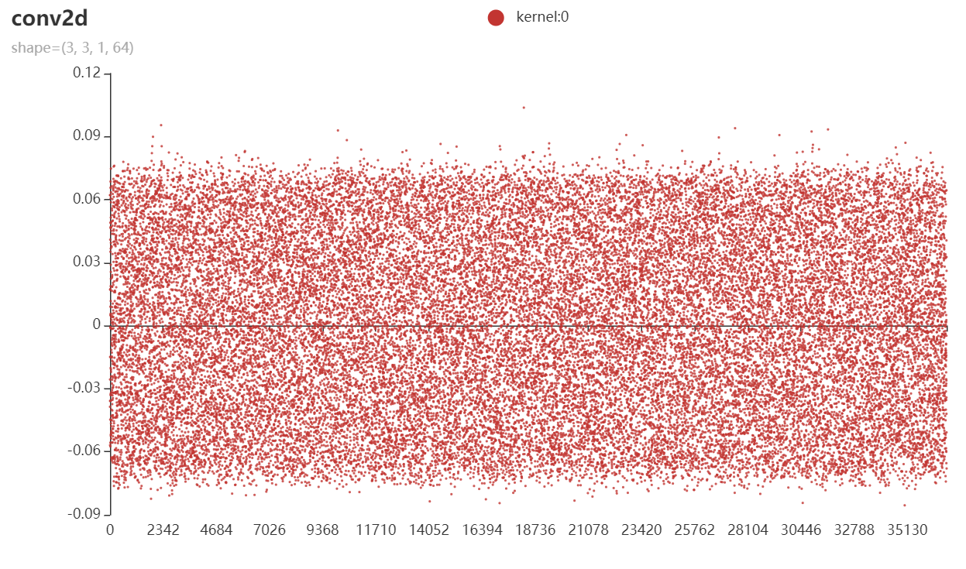
Scatter plot of Kernal Values at each layer
We can also visualize kernel value for each neuron at each layer.
From this we can see how kernel values are distributed over the kernel space.
For instance, in Layer 5, there are 36928 parameters, and we can see how the values are distributed in a certain range.
By plotting the kernel values by epochs (say after each 10/20 epochs), we can visualize the gradual change in kernel weights while training.

Slide 20
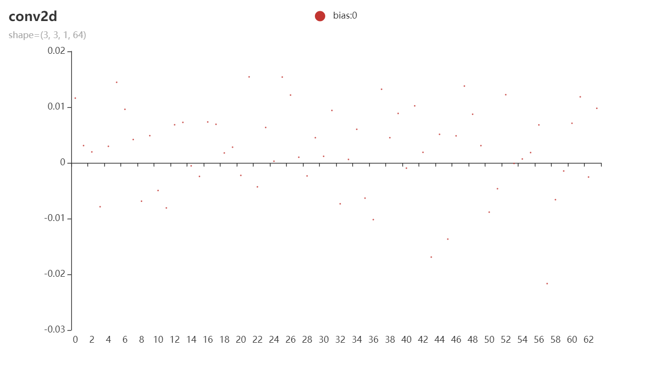
Bias at each filter
Using Tensorview API we can also extract and visualize the bias value for each filter.
Extracting bias value of each layer for every epoch, and then visualizing the data by epoch can lead us to see the trend in bias value is change while the model is learning.
If there is any learning, the value will change, otherwise not.

Slide 21
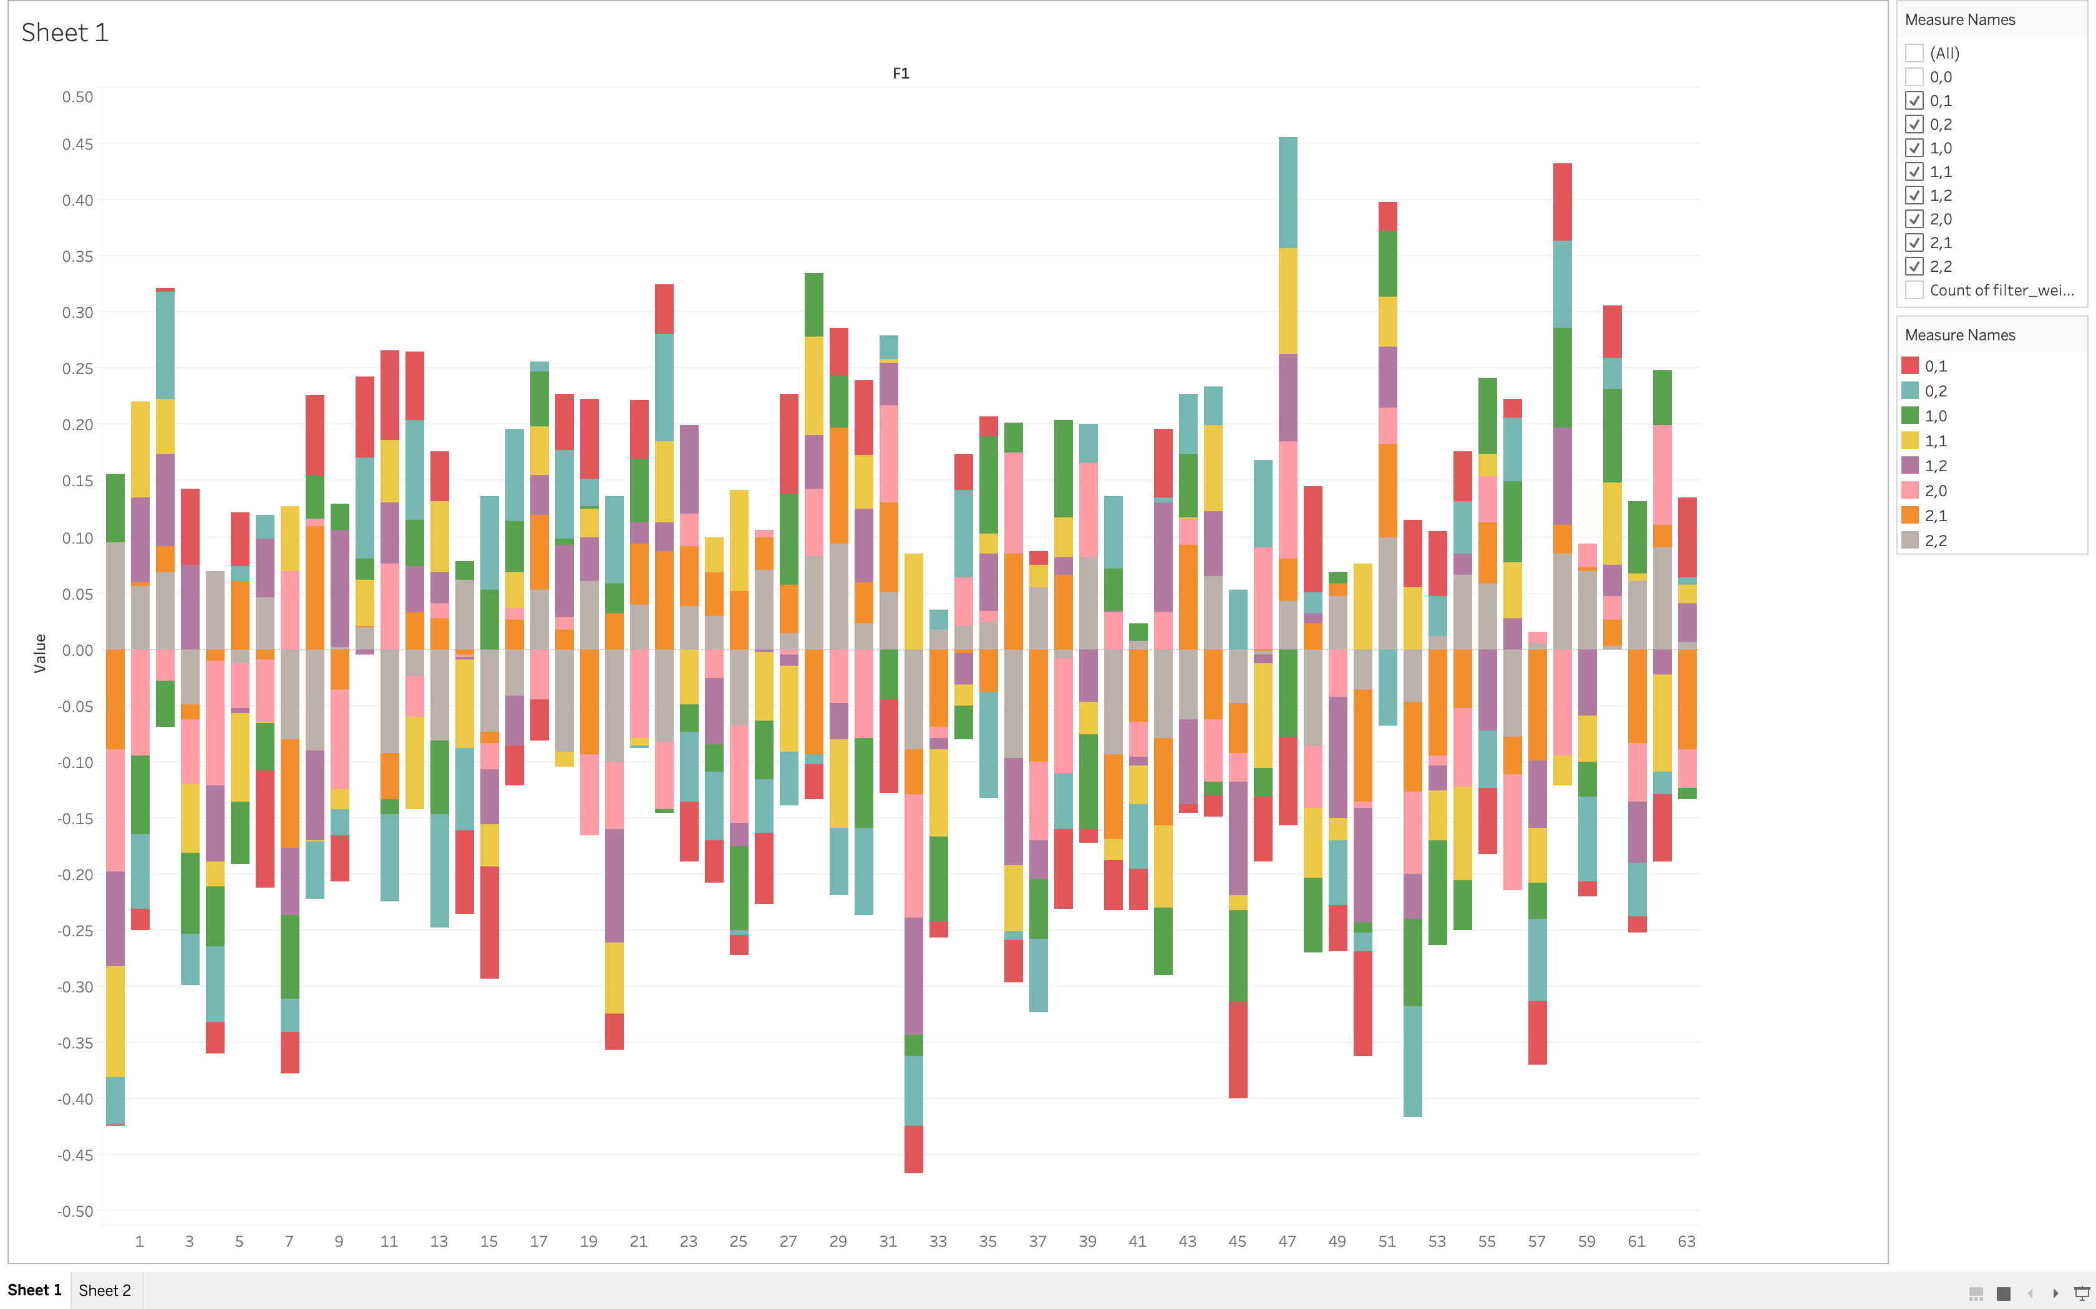
Notes:
We used 3x3 filter throughout the network, and there are different number of filter in each layer. We visualized the change in filter weights in a layer. For instance, in a layer with 64 filters, each value in 3X3 filter grid will get updated 64 times. here, we've shown the 9 grid of each filter in9 different colors.

Slide 22
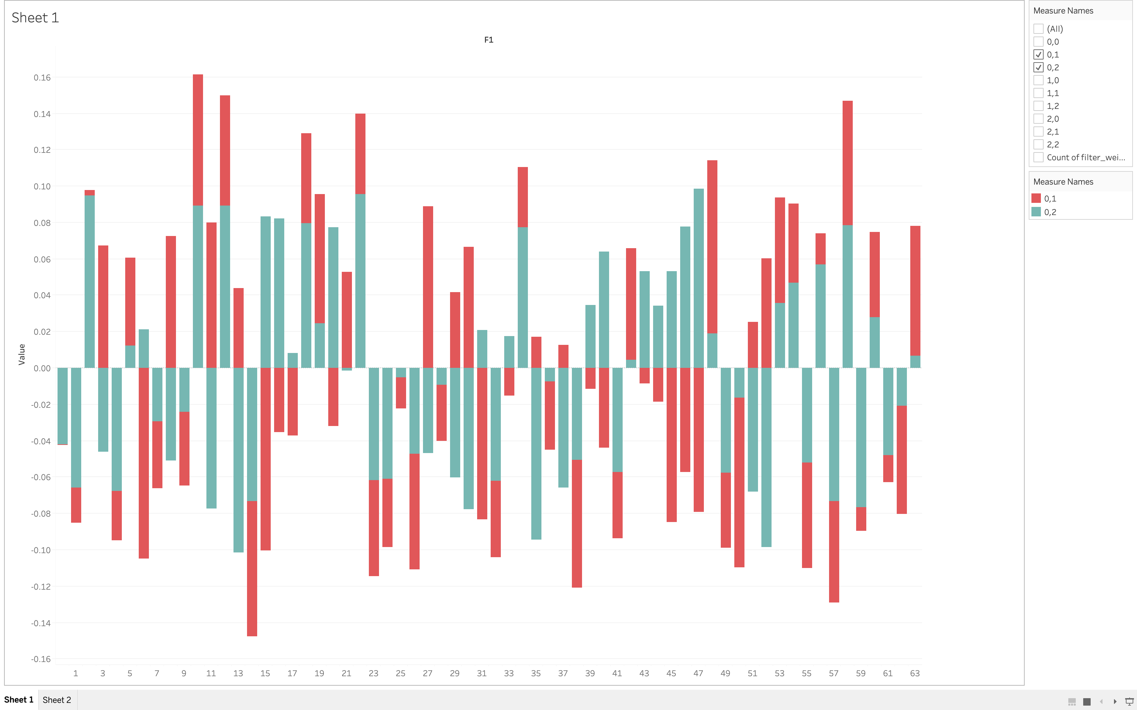
Notes:
We can see the changes for any grid in a filter. In tableau, we can select the grid number as shown on right, and we can compare and differentiate the changes between multiple grids, which will surely gice us insight and understanding of the weight value change.

Slide 23
Challenges

Slide 24
Challenges
TensorView API is a new API which is still in beta phase and the documentation is very limited.
Paraview is a complex tool to learn.
Related literature does not specify in much details, how they got the values that they visualized.

Slide 25
References
1. Machine Learning Explainability vs Interpretability: Two concepts that could help restore trust in AI - KDnuggets
2. Hall, Patrick. "On the art and science of machine learning explanations." arXiv preprint arXiv:1810.02909 (2018).
3. A. Barredo Arrieta, N. D´ıaz-Rodr´ıguez, J. Del Ser, A. Bennetot, S. Tabik, A. Barbado, S. Garcia, S. Gil-Lopez, D. Molina, R. Benjamins, R. Chatila, and F. Herrera. Explainable artificial intelligence (xai): Concepts, taxonomies, opportunities and challenges toward responsible ai. Information Fusion, 58:82–115, 2020. doi: 10.1016/j. Inffus.2019.12.012
4. https://pypi.org/project/tensorview/
5. https://www.paraview.org/download/
6. Covid image dataset: https://github.com/ieee8023/covid-chestxray-dataset
7. Non-covid image dataset: https://www.kaggle.com/paultimothymooney/chest-xray-pneumonia

Slide 26
Thank you

